Slide 1
Multiple Linear Regression
Sourav Karmakar
souravkarmakar29@gmail.com

Slide 2
OUTLINE
Multiple Linear Regression: Hypothesis Function
Cost Function
Gradient Descent Algorithm
Stopping criteria for Gradient Descent
How to check if Gradient Descent is Working
Implementation Note
Choosing the value of learning rate
Feature Scaling

Slide 3
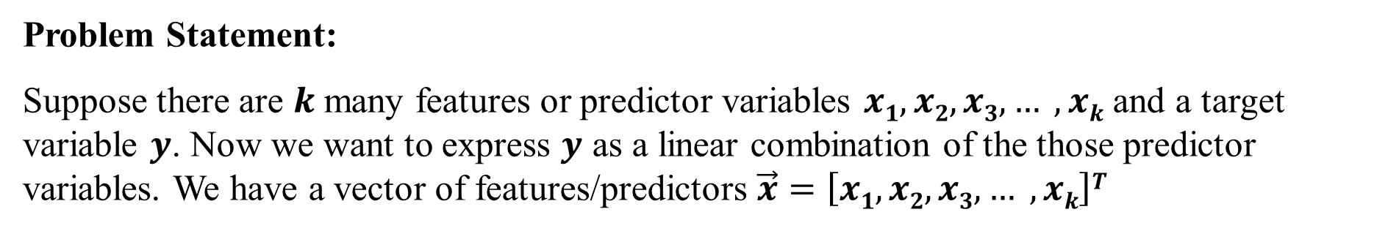
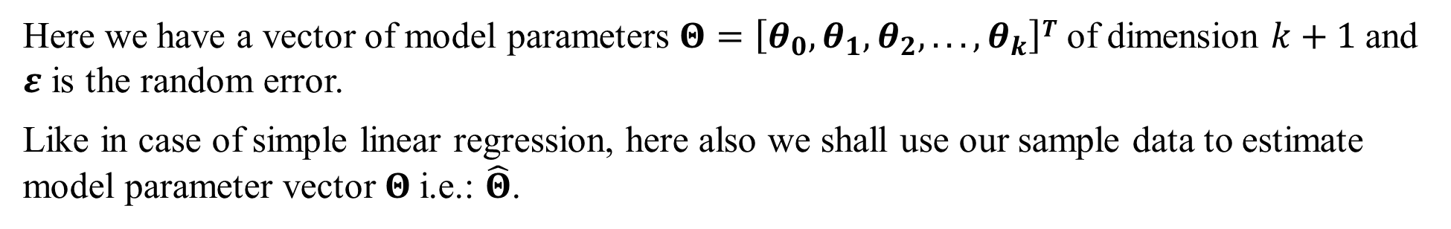
Multiple Linear Regression : Hypothesis
Model Representation:
Here, we can express our multiple linear regression problem by means of following probabilistic model.

Slide 4
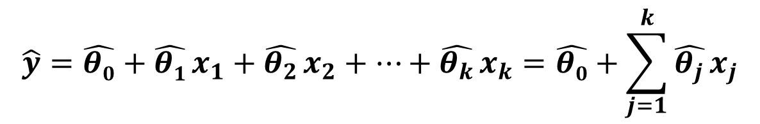
Multiple Linear Regression : Assumptions
Multiple Linear Regression Assumptions:
The target variable (y) should be linearly dependent on predictor variables (X).
The predictors should be uncorrelated and linearly independent of one another.
The model’s error term should have constant variance (Homoscedasticity)
The error term is preferably normally distributed with zero mean.
Hypothesis Function:
The predicted value of the target variable is obtained from the estimated model parameter as:

Slide 5

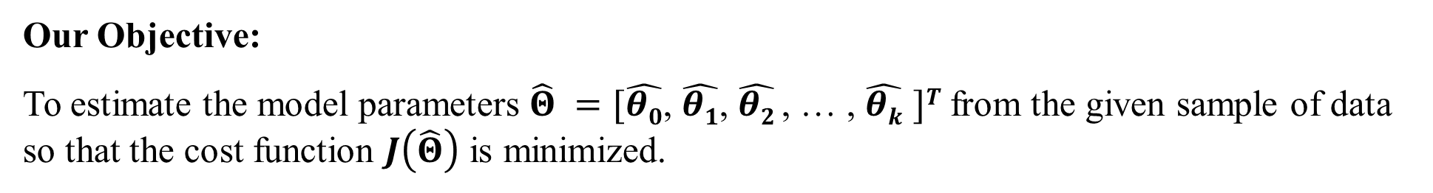
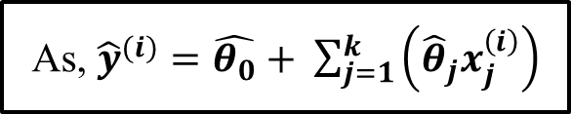
Multiple Linear Regression : Cost Function
Cost Function:
Here, we shall define cost function in the following way:
As, ${\hat{y}}^{(i)}=\hat{θ_{0}}+ \sum_{j=1}^{k}{\left({\hat{θ}}_{j}x_{j}^{\left(i\right)}\right)}$

Slide 6
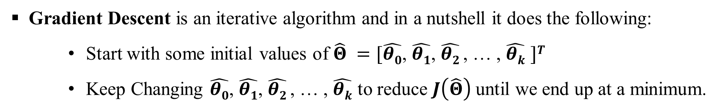
Multiple Linear Regression : Optimization
Gradient Descent algorithm for Cost Function optimization:

Slide 7
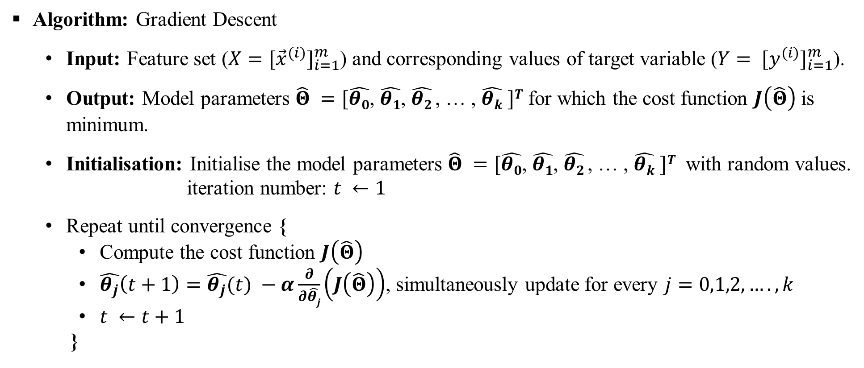
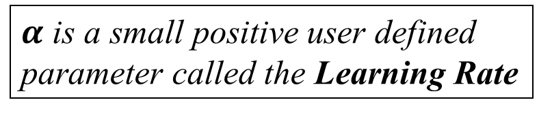
Gradient Descent Algorithm

Slide 8
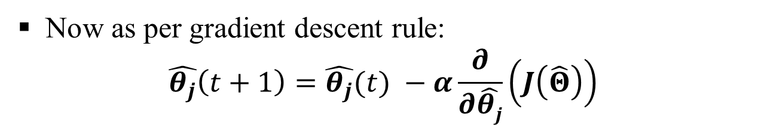

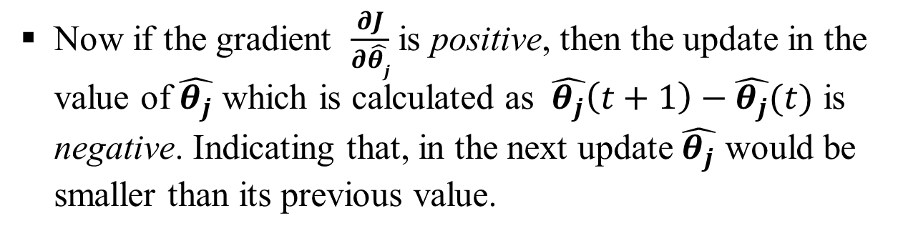
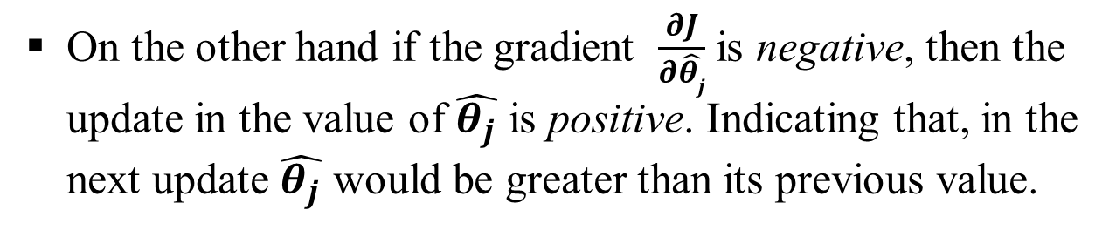




Gradient Descent Algorithm : Intuition
Intuition of Gradient Descent algorithm:
The plot of cost function with any of the parameters (considering the other parameters fixed) is of the following form.

Slide 9





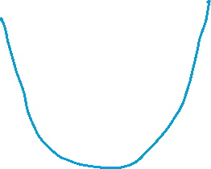
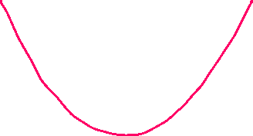


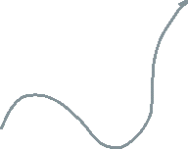


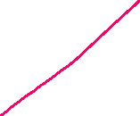
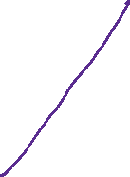



Slide 10
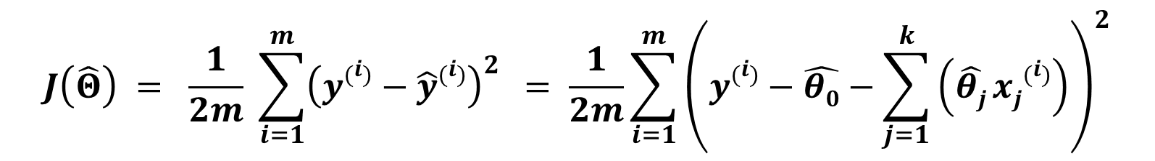

Gradient of Cost Function
The Cost Function for Linear Regression with multiple predictor variable is:

Slide 11
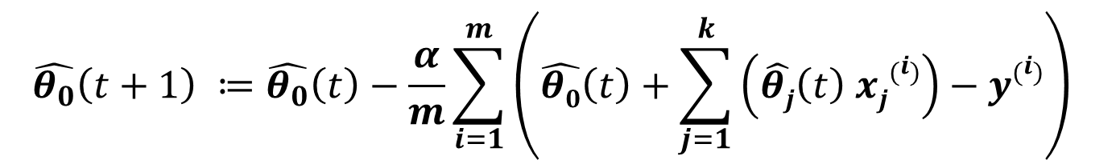
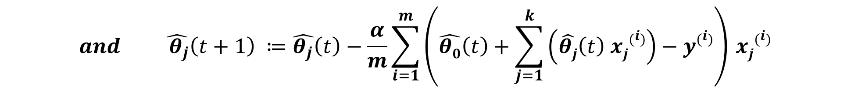



Gradient Descent update rule
$${\hat{y}}^{\left(i\right)}(t)$$
$${\hat{y}}^{\left(i\right)}(t)$$
Note:

Slide 12
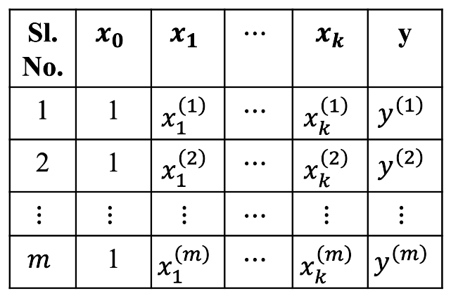
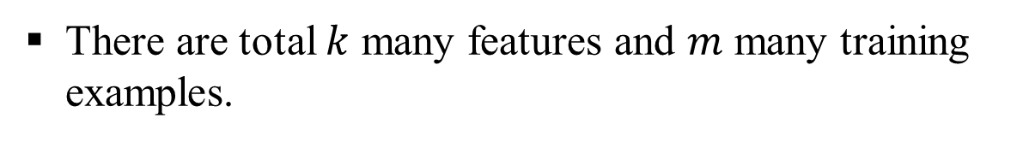
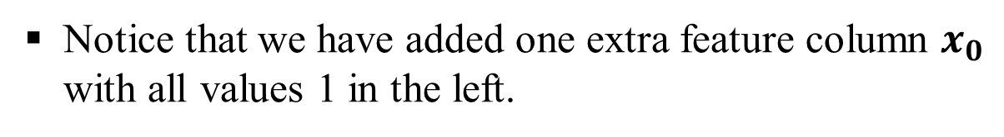

Gradient Descent update rule
Training Data Set can be written as following:
Hence, the Gradient Descent update rule for the parameters of linear regression (for $t^{th}$ iteration) is:
$$\hat{θ_{j}}\left(t+1\right)≔\hat{θ_{j}}\left(t\right)− \frac{α}{m} \sum_{i=1}^{m}{\left({\hat{y}}^{\left(i\right)}(t) −y^{\left(i\right)}\right)}x_{j}^{\left(i\right)}$$
$$for j=0, 1, 2, 3, …, k and x_{0}^{\left(i\right)}=1, ∀i∈\left[m\right]$$

Slide 13
Gradient Descent : Stopping Criteria
Stopping criteria for gradient descent:
We can consider following two methods as stopping criteria for the gradient descent algorithm.
Convergence of the model parameters:
If in two successive iterations the change in the model parameters is not significant then we can say that the algorithm has converged. As the model parameters are vectors, to compare the values of the model parameters in two successive iterations we can either take norm or absolute differences. Alternatively if at least one of the parameters is not converged then we keep on running the algorithm until all the parameters are converged.
2. Predefined number of iterations:
We run the algorithm for predefined number of iterations.

Slide 14















Slide 15















Slide 16
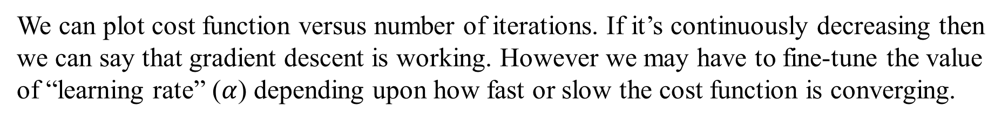
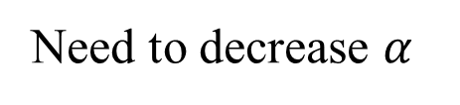
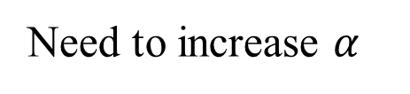
Gradient Descent : Troubleshooting
How to check whether gradient descent is working or not:
J
J
J
iterations
iterations
iterations
Gradient Descent working properly
Gradient Descent not working properly

Slide 17
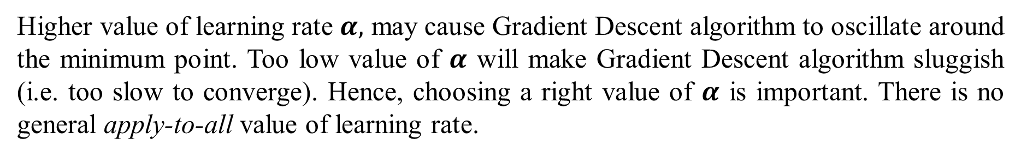
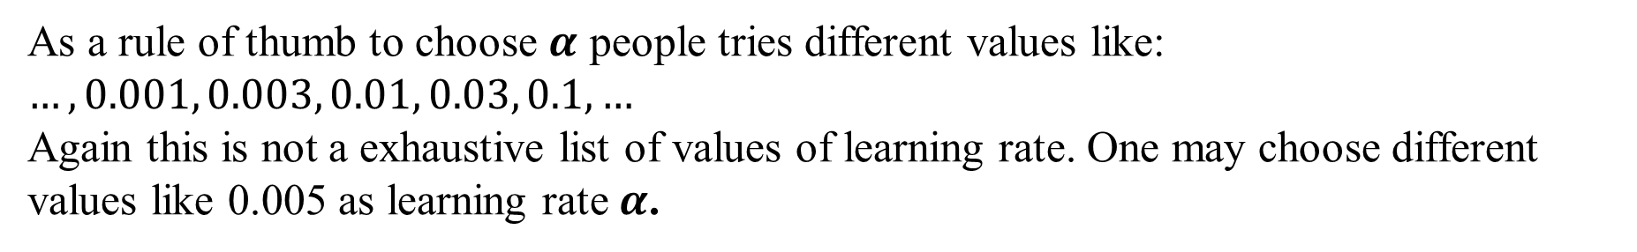
Gradient Descent : Implementation Note

Slide 18
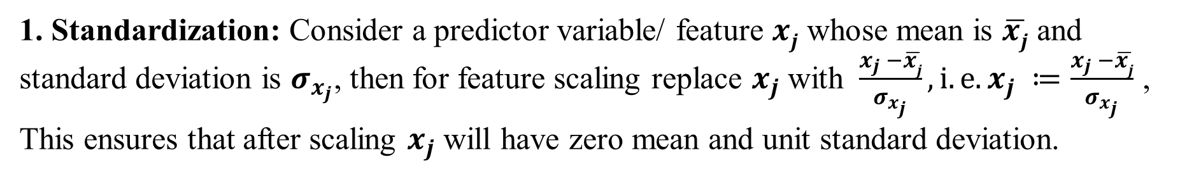
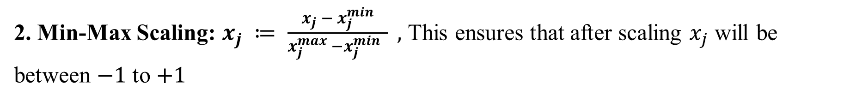
Gradient Descent : Implementation Note
Implementation Note-2: Feature Scaling:
Linear Regression and most of the other Machine Learning algorithms performs well when the range of the predictor variables are roughly in the same range. This is because, if the range of one predictor variable is significantly higher than another predictor variable, then the first one starts to dominate over the second one, making Gradient Descent algorithm sluggish. Hence, Feature Scaling is necessary for faster convergence of Gradient Descent algorithm. This done by either of the following two methods.
2. Min-Max Scaling: $x_{j} ≔ \frac{x_{j} − x_{j}^{min}}{x_{j}^{max} −x_{j}^{min} } ,$ This ensures that after scaling $x_{j}$ will be between $−1$ to $+1$

Slide 19
Thank You

